Slide 1


Dual Power BI Setup Methods
Deploying via Microsoft Store & Official Web Browser Installer

Slide 2
Method 1: Microsoft Store
The streamlined path for automated background updates

Slide 3


Why Use the Store Method?
No Admin Access Required
Automated Monthly Updates
Because Windows handles the package updates securely via the system catalog, you can install and update Power BI without constant administrator credential prompts.
Microsoft pushes updates for Power BI Desktop each month. The store client automatically updates it silently in the background, saving you manual downloads.

Slide 4

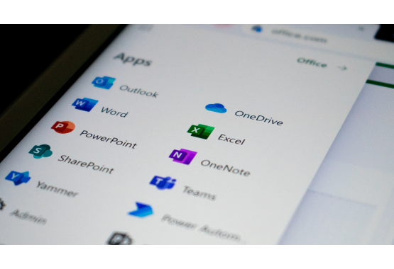
Microsoft Store Workflow
Installing via Store App
A quick, clean method for general analytics laptops:
➔
Open the Microsoft Store app from your Windows taskbar.
➔
Type "Power BI Desktop" into the top central search field.
➔
Choose the official Microsoft software page.
➔
Click the blue "Get" / "Install" button to trigger silent installation.

Slide 5
Method 2: Browser Download
The classic offline MSI file installation approach

Slide 6




Acquiring Power BI Desktop
2. Search Tool
4. Download
Type "Microsoft Power BI Desktop Download" in search bar.
Click download and choose the setup executable file to save to disk.
1. Open Browser
3. Official Source
Launch Google Chrome or any modern browser of choice.
Access the official Microsoft download source to bypass unsafe portals.

Slide 7
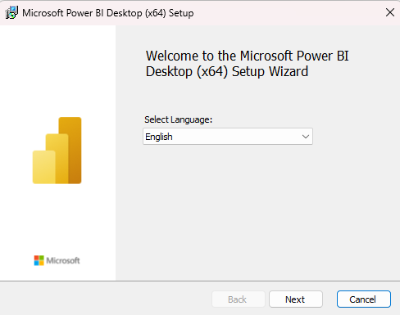
Installing Power BI Desktop
Step 5: Run the Setup Wizard
Locate the downloaded installation file on your PC and launch the step-by-step assistant wizard.
Launch the setup executable file
Agree to the Microsoft Licensing Terms
Select destination path and click "Install"
Open Power BI Desktop once ready!

Slide 8


Store vs. Browser Comparison
Microsoft Store Benefits
Web Browser Benefits
➔
Zero maintenance background updates.
➔
Great for restricted machines blocks.
➔
Highly secured isolated app environment.
➔
Allows rollback to older corporate target builds.
➔
Zero corporate administrator access pop-ups required.
➔
Easily distributable via deployment scripts.

Slide 9

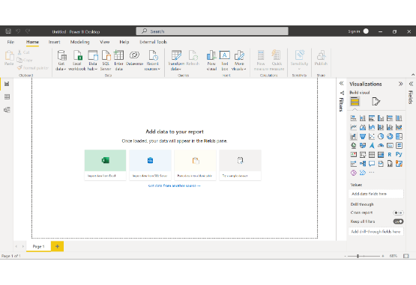
Your First Launch Workspace
Launching the Environment
Once installation finishes, initialize Power BI Desktop from your local search bar or desktop shortcut.
Bypass Sign-In: You do not need a corporate domain to start! Simply close out the prompt or click "Skip" to access local creation tools.
Select "Blank Report" to unlock a fresh blank slate canvas.

Slide 10


Core Global Settings Options
1. Global Security Settings
2. Preview Features
Navigate to: File → Options and Settings → Options
Stay ahead of industry standards with emerging product interfaces:
→
Click directly on the Security tab.
→
Enable Data Extensions explicitly to support external data connectors.
→
Activate the dynamic On-object interaction to edit charts directly.
→
Enable Trusted Certificates to ensure seamless connectivity between varying relational platforms.

Slide 11




Essential File Settings
Auto-Detect Relationships
Save Settings Configuration
Enable "Auto Detect Relationships" under Data Load. Power BI will auto-map table links in the backend model view cleanly.
Click "OK" to save and secure active properties, updating your environment global parameters instantly for future analytics work.

Slide 12
Ready Verification Check
Confirm Readiness Before Starting
100%
Ensure that every single workspace checkpoint is completed before moving forward into active data exploration and formula coding:
✔ Desktop application launched on home system.
✔ Initial splash screen successfully skipped/bypassed.
✔ Security protocols configured and relationships set to auto-map.
WORKSPACE CONFIGURED

